Slide 1
CT216 Lecture 1 Part 3
MIMO, OFDM, and Multiple Access
Reference: Tse, David, and Pramod Viswanath. Fundamentals of wireless communication. Cambridge university press, 2005.

Slide 2
An Overview of Multiple Input Multiple Output (MIMO) Communication Systems

Slide 3
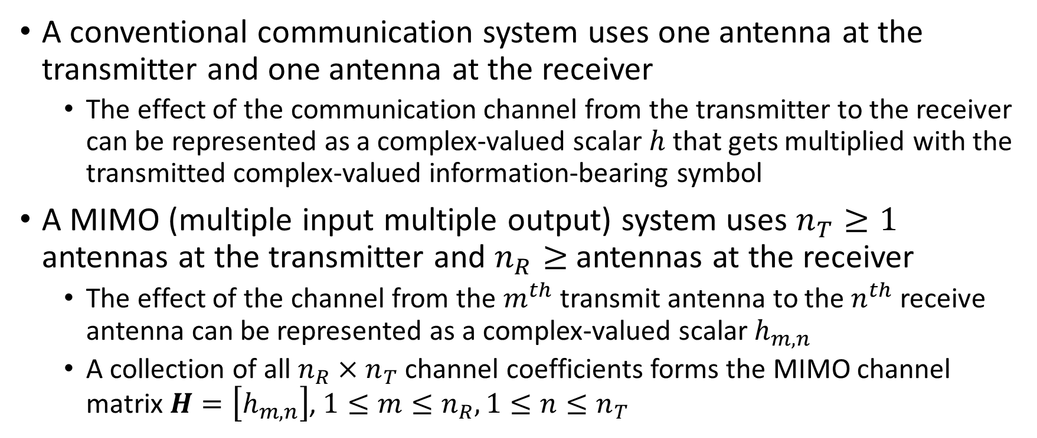
MIMO Channel Model
A conventional communication system uses one antenna at the transmitter and one antenna at the receiver
The effect of the communication channel from the transmitter to the receiver can be represented as a complex-valued scalar $h$ that gets multiplied with the transmitted complex-valued information-bearing symbol
A MIMO (multiple input multiple output) system uses $n_{T}≥1$ antennas at the transmitter and $n_{R}≥$ antennas at the receiver
The effect of the channel from the $m^{th}$ transmit antenna to the $n^{th}$ receive antenna can be represented as a complex-valued scalar $h_{m,n}$
A collection of all $n_{R}×n_{T}$ channel coefficients forms the MIMO channel matrix $H=\left[h_{m,n}\right]$, $1≤m≤n_{R}, 1≤n≤n_{T}$

Slide 4
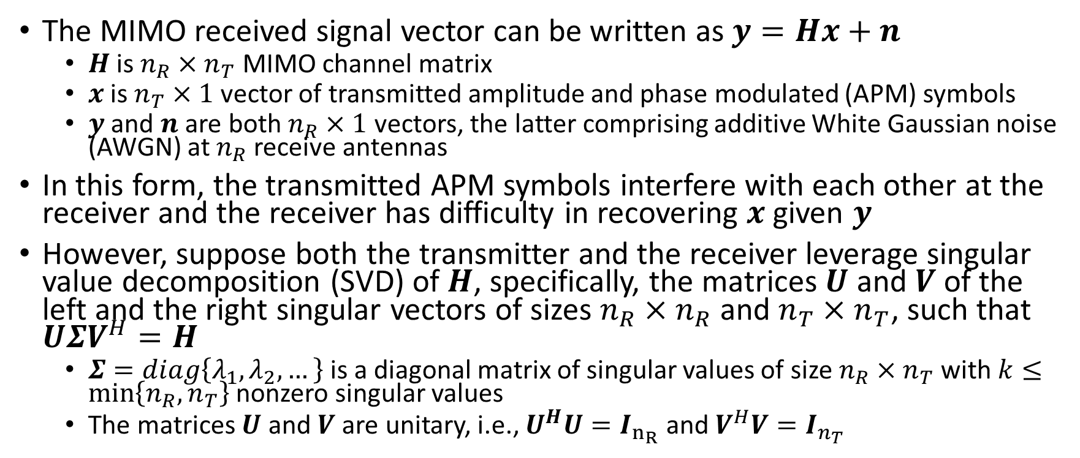
MIMO Received Signal Model
The MIMO received signal vector can be written as $y=Hx+n$
$H$ is $n_{R}×n_{T}$ MIMO channel matrix
$x$ is $n_{T}×1$ vector of transmitted amplitude and phase modulated (APM) symbols
$y$ and $n$ are both $n_{R}×1$ vectors, the latter comprising additive White Gaussian noise (AWGN) at $n_{R}$ receive antennas
In this form, the transmitted APM symbols interfere with each other at the receiver and the receiver has difficulty in recovering $x$ given $y$
However, suppose both the transmitter and the receiver leverage singular value decomposition (SVD) of $H$, specifically, the matrices $U$ and $V$ of the left and the right singular vectors of sizes $n_{R}×n_{R}$ and $n_{T}×n_{T}$, such that $UΣV^{H}=H$
$Σ=diag\left\{λ_{1},λ_{2},…\right\}$is a diagonal matrix of singular values of size $n_{R}×n_{T}$ with $k≤\min\left\{n_{R},n_{T}\right\}$ nonzero singular values
The matrices $U$ and $V$ are unitary, i.e., $U^{H}U=I_{n_{R}}$ and $V^{H}V=I_{n_{T}}$

Slide 5
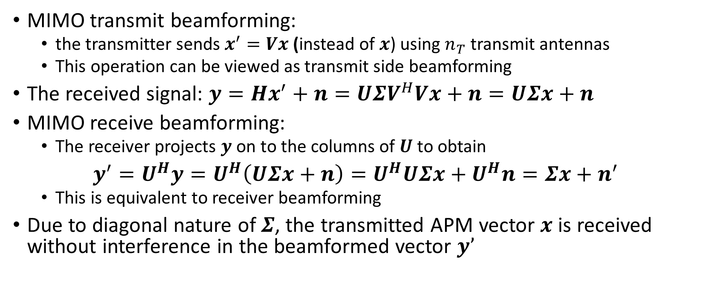
Benefit of MIMO
MIMO transmit beamforming:
the transmitter sends $x^{′}=Vx$ (instead of $x$) using $n_{T}$ transmit antennas
This operation can be viewed as transmit side beamforming
The received signal: $y=Hx^{′}+n=UΣV^{H}Vx+n=UΣx+n$
MIMO receive beamforming:
The receiver projects $y$ on to the columns of $U$ to obtain
$y^{′}=U^{H}y=U^{H}\left(UΣx+n\right)=U^{H}UΣx+U^{H}n=Σx+n^{′}$
This is equivalent to receiver beamforming
Due to diagonal nature of $Σ$, the transmitted APM vector $x$ is received without interference in the beamformed vector $y’$

Slide 6



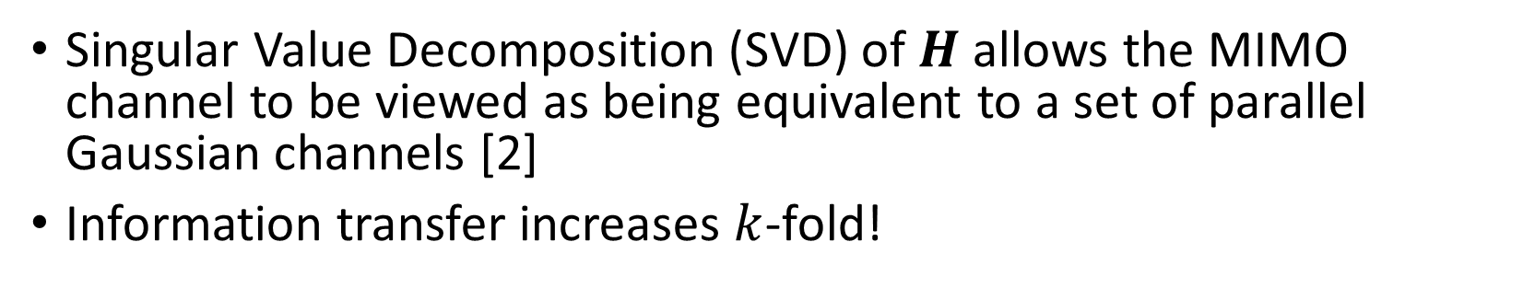











Benefit of MIMO
Singular Value Decomposition (SVD) of $H$ allows the MIMO channel to be viewed as being equivalent to a set of parallel Gaussian channels [2]
Information transfer increases $k$-fold!
$n_{R}×n_{T}$ MIMO System
After SVD ($k≤\min\left(n_{T}, n_{R}\right)$
$$h_{11}$$
$$h_{1,n_{R}}$$
$$h_{12}$$
$$λ_{1}$$
$$λ_{2}$$
$$h_{n_{T},1}$$
$$λ_{k}$$
$$n_{R}$$
$$k$$
$$k$$
$$n_{T}$$
$$h_{n_{T},n_{R}}$$

Slide 7
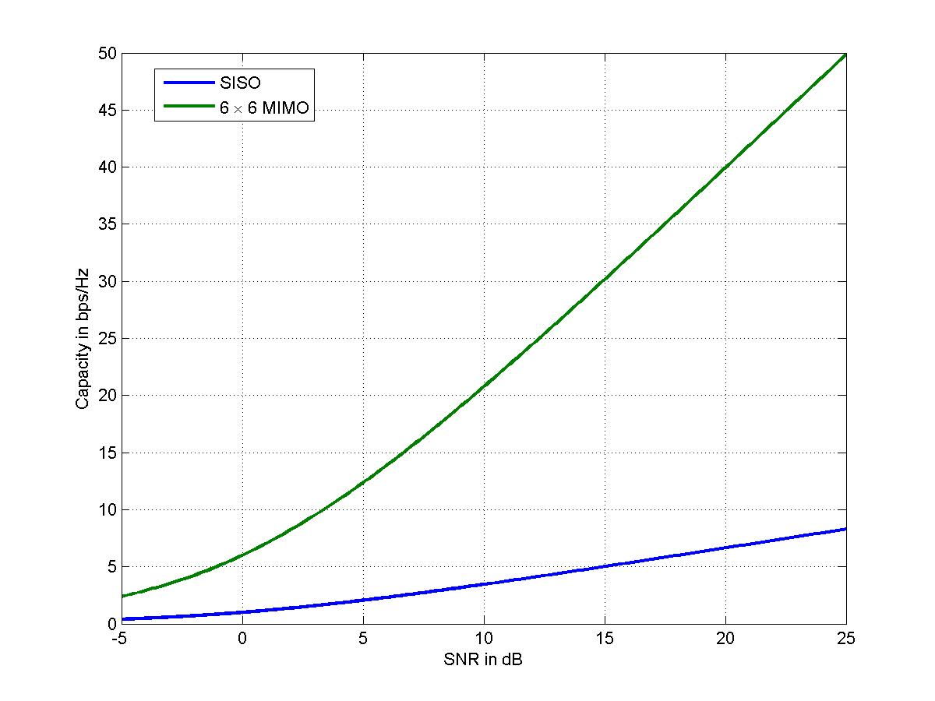
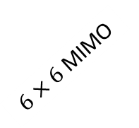
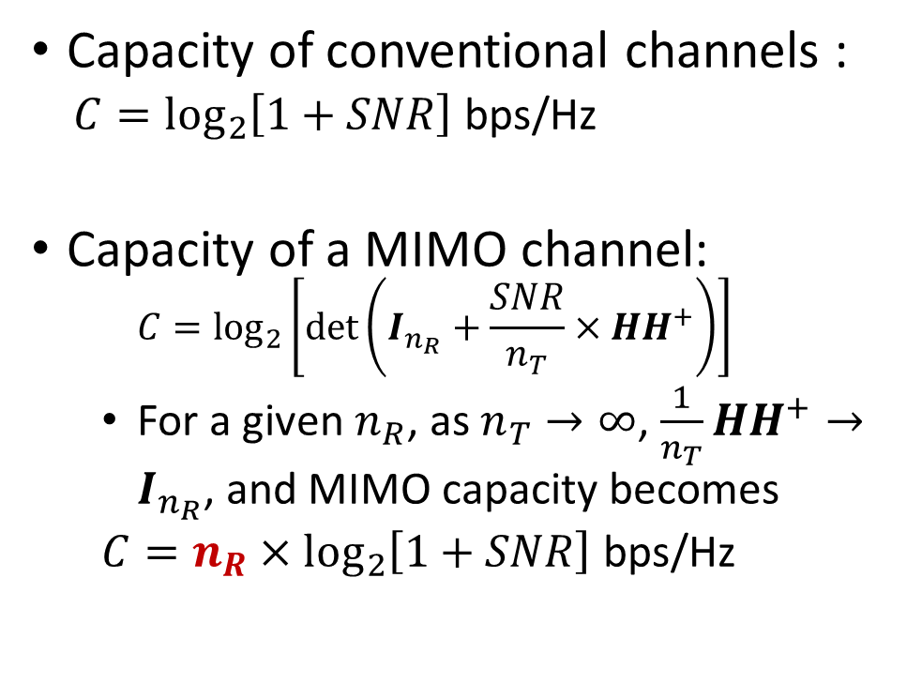

MIMO: Wherein Lies the Promise?
Capacity of $6×6$ MIMO
Capacity of conventional channels :
$C=\log_{2}\left[1+SNR\right]$ bps/Hz
Capacity of a MIMO channel:
$$C=\log_{2}\left[\det\left(I_{n_{R}}+\frac{SNR}{n_{T}}×HH^{+}\right)\right]$$
For a given $n_{R}$, as $n_{T}→∞$, $\frac{1}{n_{T}}HH^{+}→I_{n_{R}}$, and MIMO capacity becomes
$C=n_{R}×\log_{2}\left[1+SNR\right]$ bps/Hz
$6×6$MIMO
Capacity in bps/Hz
SISO
SNR in dB
It’s as if Bandwidth Increased Six Fold!
And this multiplicative gain in capacity is (at least a theoretical and asymptotical) free lunch, without any SNR penalty

Slide 8
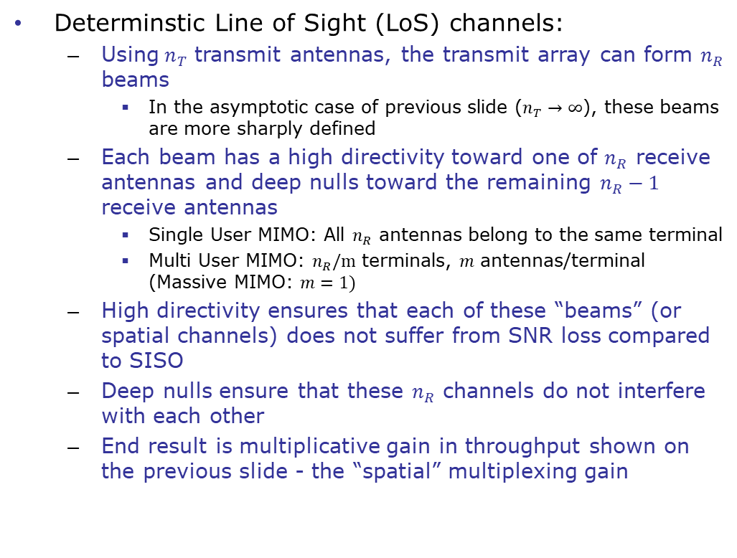
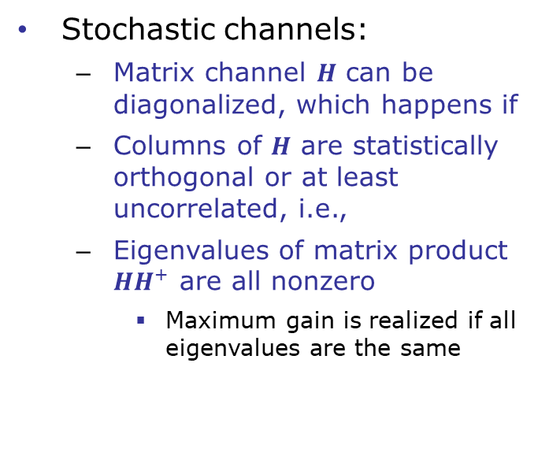
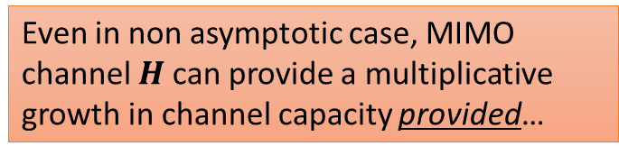
MIMO: Requirements for a Multiplicative Gain in Capacity
Even in non asymptotic case, MIMO channel $H$ can provide a multiplicative growth in channel capacity provided…
Determinstic Line of Sight (LoS) channels:
Using$n_{T}$ transmit antennas, the transmit array can form $n_{R}$ beams
In the asymptotic case of previous slide ($n_{T}→∞$), these beams are more sharply defined
Each beam has a high directivity toward one of $n_{R}$ receive antennas and deep nulls toward the remaining $n_{R}−1$ receive antennas
Single User MIMO: All $n_{R}$ antennas belong to the same terminal
Multi User MIMO: $n_{R}/m$ terminals, $m$ antennas/terminal (Massive MIMO: $m=1)$
High directivity ensures that each of these “beams” (or spatial channels) does not suffer from SNR loss compared to SISO
Deep nulls ensure that these $n_{R}$ channels do not interfere with each other
End result is multiplicative gain in throughput shown on the previous slide - the “spatial” multiplexing gain
Stochastic channels:
Matrix channel $H$ can be diagonalized, which happens if
Columns of $H$ are statistically orthogonal or at least uncorrelated, i.e.,
Eigenvalues of matrix product $HH^{+}$ are all nonzero
Maximum gain is realized if all eigenvalues are the same

Slide 9
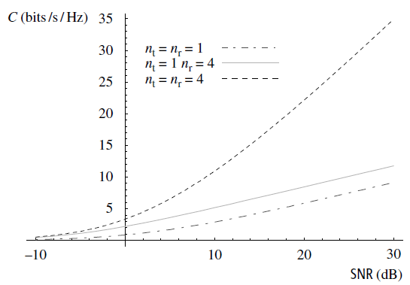
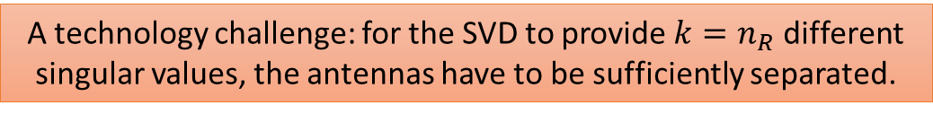
A technology challenge: for the SVD to provide $k=n_{R}$ different singular values, the antennas have to be sufficiently separated.
Borrowed from: [2]

Slide 10
Orthogonal Frequency Division Multiplexing (OFDM)
Reference:
Tse, David, and Pramod Viswanath. Fundamentals of wireless communication. Cambridge university press, 2005.

Slide 11
OFDM: Summary
From late nineties to early 2000s, the entire telecommunication industry developed (engineered) and implemented (on ASICs and FPGAs on the base-stations and at the user terminals) non-OFDM waveforms such as multicarrier-TDMA (GSM) or CDMA (cdma200, wcdma, etc.)
OFDM replaced that entire infrastructure!
The reason: the diagonalization of the channel matrix through eigenvalue decomposition (an example of the sheer power that the math wields in practical world affairs!)
Allowed a far simpler receiver implementation (cost, complexity, energy benefit) since OFDM bypasses the need of (e.g., zero-forcing) LSI channel equalization
OFDM transforms a frequency-selective wireless channel into a frequency-flat channel for which the equalization is not needed
This is achieved by making the symbol duration (the length of the complex sinusoids, which are the eigenfunctions of the circulant channel matrix) larger

Slide 12
OFDM and a Model of Wireless Channel with Intersymbol Interference (ISI)

Slide 13
OFDM and a Model of Wireless Channel with ISI
is the convolution matrix (Toeplitz)

Slide 14

Eigendecomposition of the Channel with ISI
The channel with ISI is an LTI system, which has the complex exponentials (sinusoids) as its eigenfunctions
However, $N_{b}$ is required to be infinite for this property to hold
Unless matrix $H$ is converted to the following circulant matrix
Each row is the prior row right shifted by one
Requires adding several nonzero elements in upper right corner
This is achieved by adding a cyclic prefix to vector $b$

Slide 15
View of OFDM as Linear Precoding

Slide 16
View of OFDM as Linear Precoding
Conclusion: by applying DFT precoding and appending cyclic prefix, the channel with ISI (cross-connectivity across symbols) is transformed into a diagonal channel without ISI, thereby simplifying the channel equalization

Slide 17
An Comparison of Multiple Access Schemes: Two User Channel Capacity

Slide 18
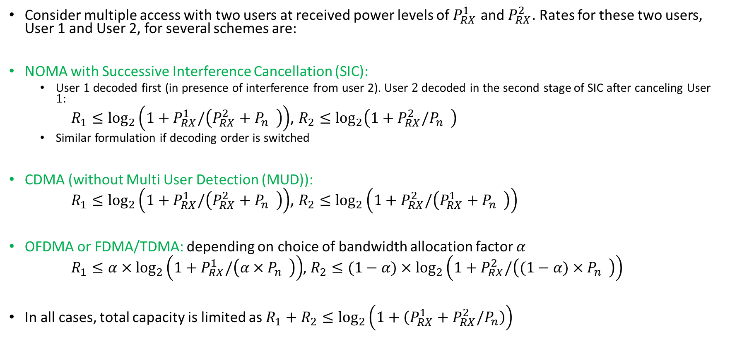
Two-User Capacity Formulations for Several Multiple Access Schemes
Consider multiple access with two users at received power levels of $P_{RX}^{1}$ and $P_{RX}^{2}$. Rates for these two users, User 1 and User 2, for several schemes are:
NOMA with Successive Interference Cancellation (SIC):
User $1$ decoded first (in presence of interference from user 2). User $2$ decoded in the second stage of SIC after canceling User $1$:
$R_{1}≤\log_{2}\left(1+P_{RX}^{1}/\left({P_{RX}^{2}+P}_{n}^{}\right)\right)$, $R_{2}≤\log_{2}\left(1+P_{RX}^{2}/P_{n}^{}\right)$
Similar formulation if decoding order is switched
CDMA (without Multi User Detection (MUD)):
$R_{1}≤\log_{2}\left(1+P_{RX}^{1}/\left({P_{RX}^{2}+P}_{n}^{}\right)\right)$, $R_{2}≤\log_{2}\left(1+P_{RX}^{2}/\left({P_{RX}^{1}+P}_{n}^{}\right)\right)$
OFDMA or FDMA/TDMA: depending on choice of bandwidth allocation factor $α$
$R_{1}≤α×\log_{2}\left(1+P_{RX}^{1}/\left(α×P_{n}^{}\right)\right)$, $R_{2}≤(1−α)×\log_{2}\left(1+P_{RX}^{2}/\left((1−α)×P_{n}^{}\right)\right)$
In all cases, total capacity is limited as $R_{1}+R_{2}≤\log_{2}\left(1+\left(P_{RX}^{1}+P_{RX}^{2}/P_{n}\right)\right)$

Slide 19
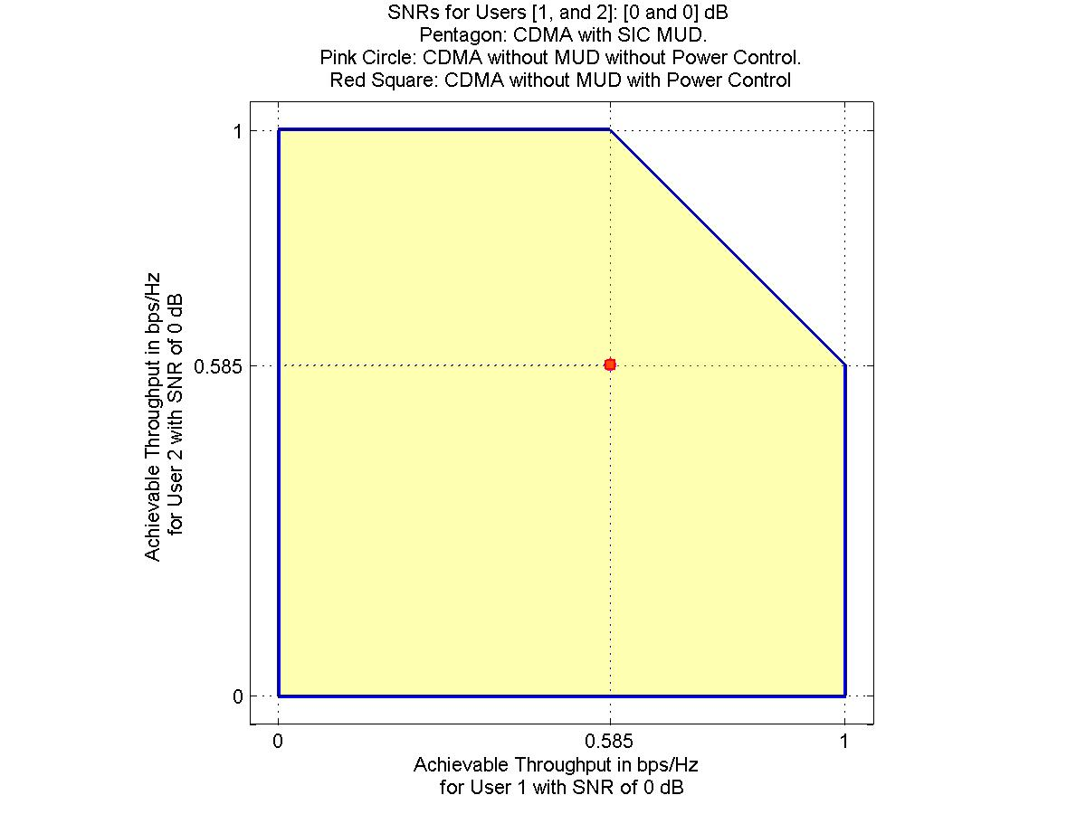


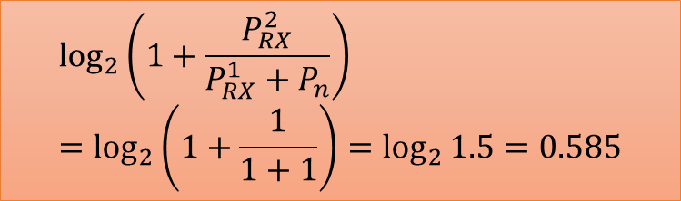
NOMA allows operation at any point along this pentagon
Operation along this line is strictly better than conventional CDMA (red dot)
$$\log_{2}\left(1+\frac{P_{RX}^{2}}{P_{n}}\right)$$
$\log_{2}\left(1+\frac{P_{RX}^{1}+P_{RX}^{2}}{Pn}\right)=1.585$
$$\log_{2}\left(1+\frac{P_{RX}^{2}}{{P_{RX}^{1}+P}_{n}}\right)=\log_{2}\left(1+\frac{1}{1+1}\right)=\log_{2}{1.5}=0.585$$

Slide 20
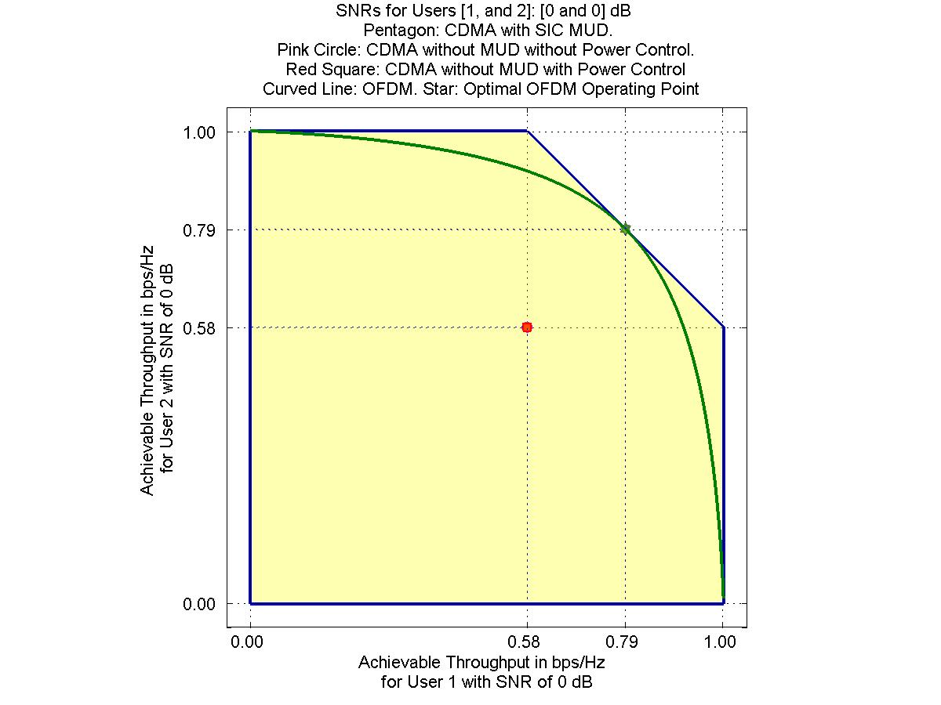
NOMA dominates OMA, except at one point at which OMA performance matches that of NOMA

Slide 21
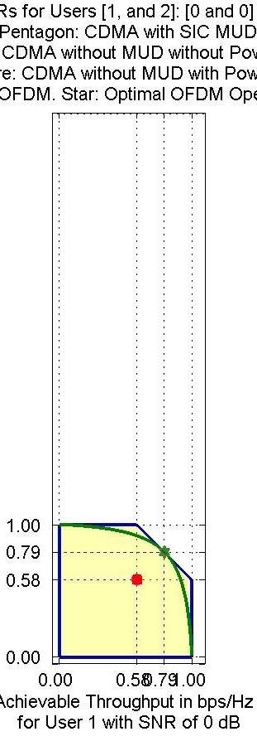
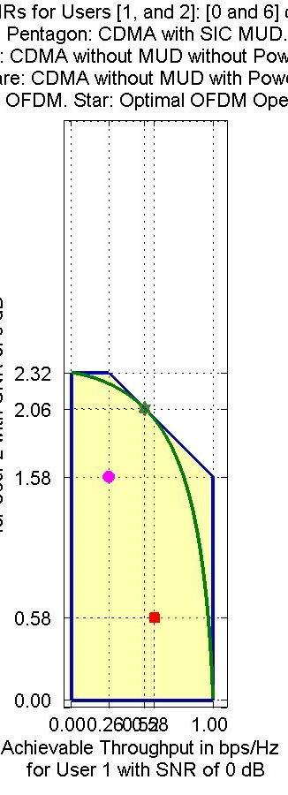
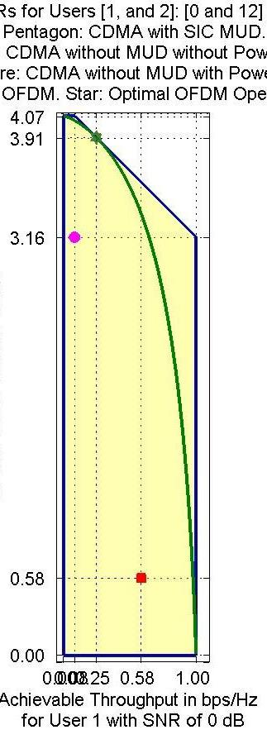
Received Power Differential:
0 dB
Received Power Differential:
6 dB
Received Power Differential:
12 dB
When received powers of the two users are mismatched,
NOMA can operate at a vertex of the pentagon (marked by blue circle) that is optimal as well as fair to both the users
OFDM can achieve optimality but at the expense of fairness to lower powered user
CDMA cannot achieve optimality

